Slide 2
CHILDREN & DIGITAL MEDIA
Ms Aisha Yasmeen
Markazi nigran shoba atfal
JI women wing,Pakistan
www.jamaatwomen.org

Slide 3
www.jamaatwomen.org

Slide 4
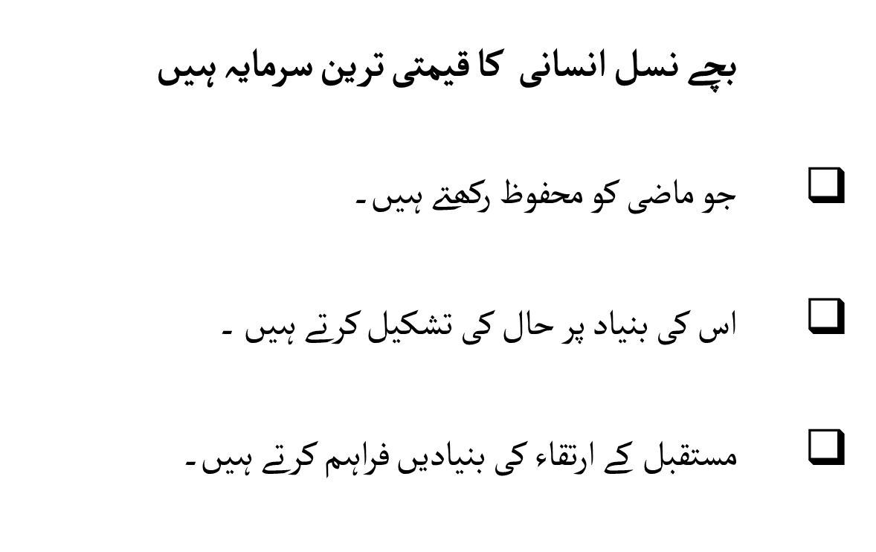
www.jamaatwomen.org

Slide 5
www.jamaatwomen.org

Slide 6
www.jamaatwomen.org

Slide 7
www.jamaatwomen.org

Slide 8
www.jamaatwomen.org

Slide 9
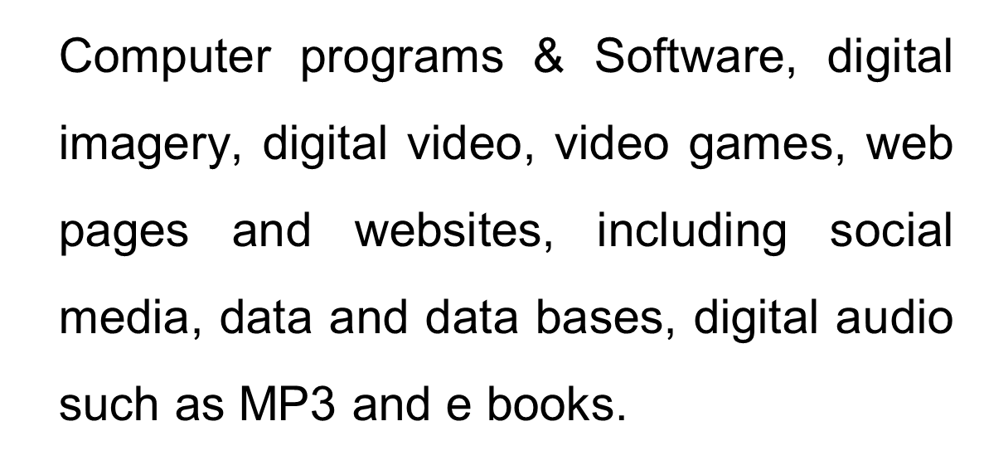
www.jamaatwomen.org

Slide 10
www.jamaatwomen.org

Slide 11
www.jamaatwomen.org

Slide 12
www.jamaatwomen.org

Slide 13
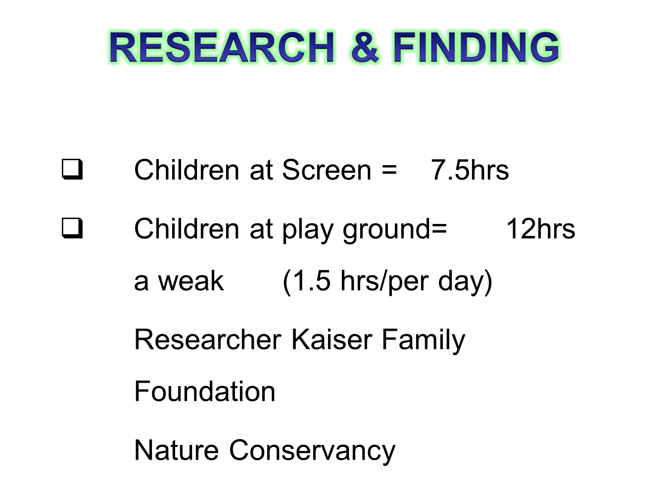
www.jamaatwomen.org

Slide 14
www.jamaatwomen.org

Slide 15
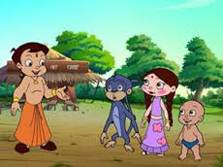
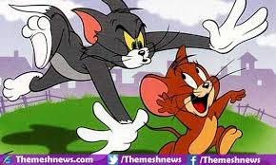
www.jamaatwomen.org

Slide 16
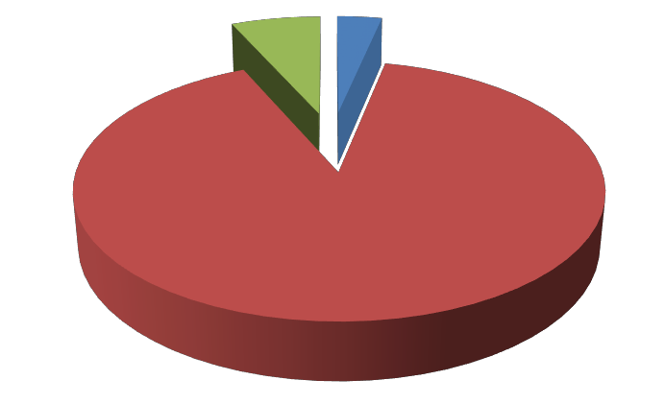
10-40%
41-70%
71-100%
www.jamaatwomen.org

Slide 17
www.jamaatwomen.org

Slide 18
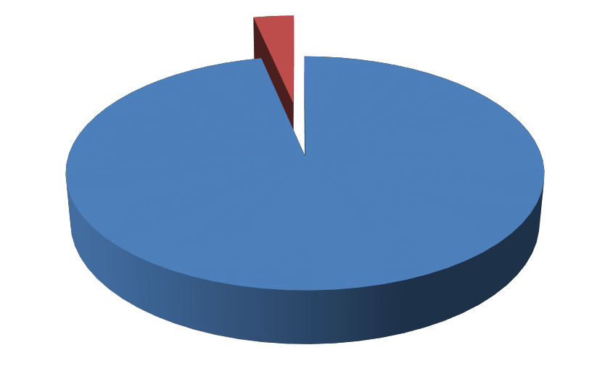
Yes
No
Sometimes
www.jamaatwomen.org

Slide 19
www.jamaatwomen.org

Slide 22
www.jamaatwomen.org

Slide 23
CALSSIFYING THEM WITH NAME OF THEIR FAVOURITE CARTOON CHARACTER
Yes
No
Sometimes
www.jamaatwomen.org

Slide 24
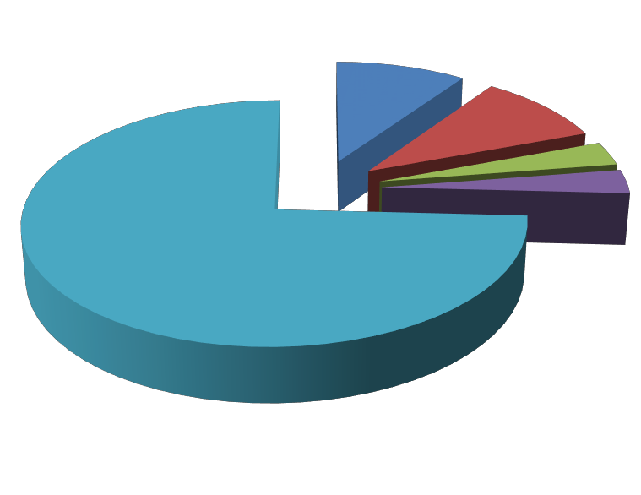
IMPACTFUL FEATURE OF CARTOON FOR CHILDREN
Behavior
Personality
Music
Speeches
All of the above
www.jamaatwomen.org

Slide 25
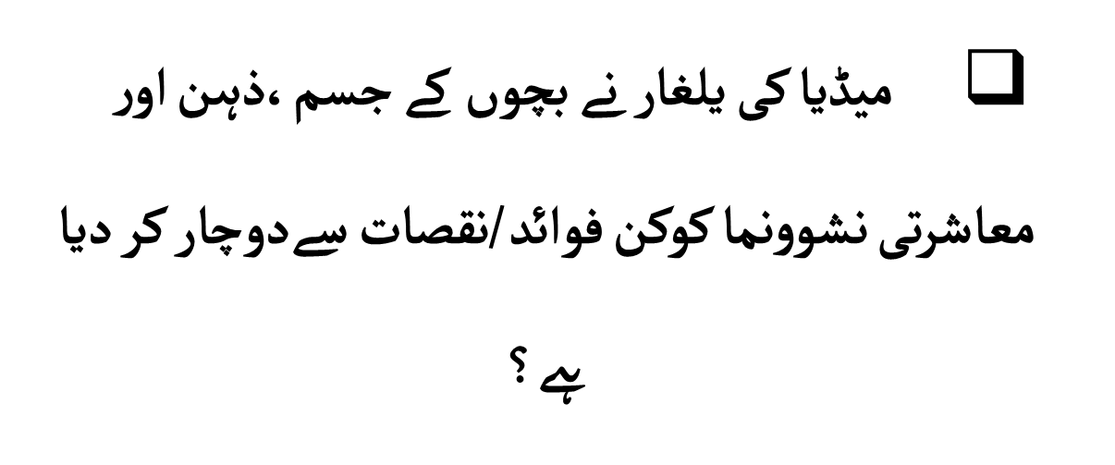
www.jamaatwomen.org

Slide 26
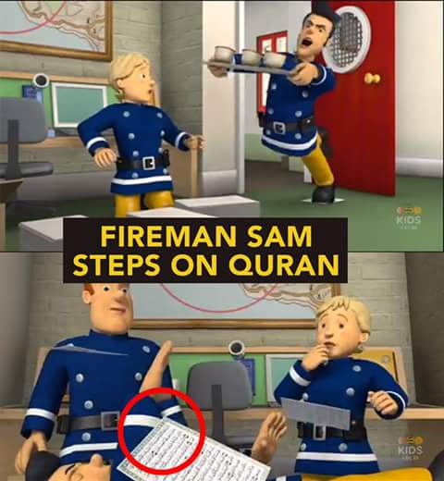
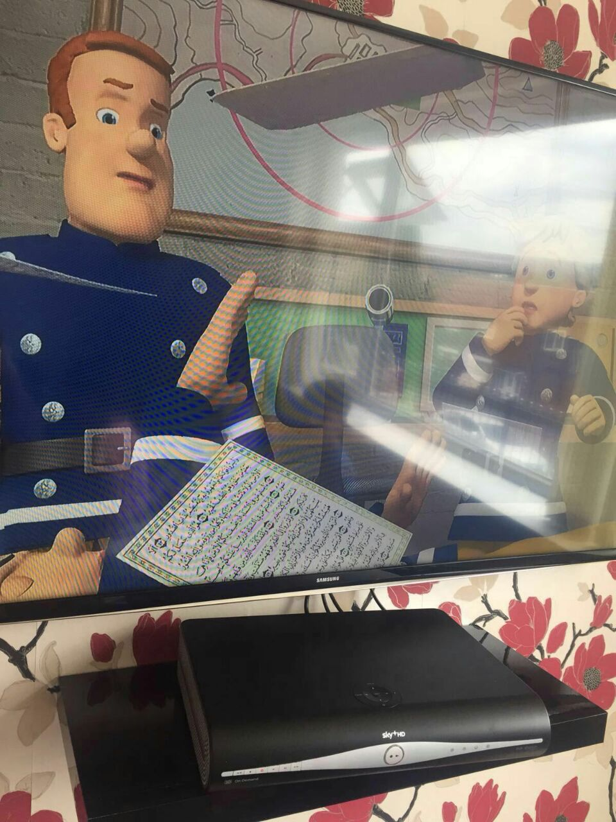
www.jamaatwomen.org

Slide 27
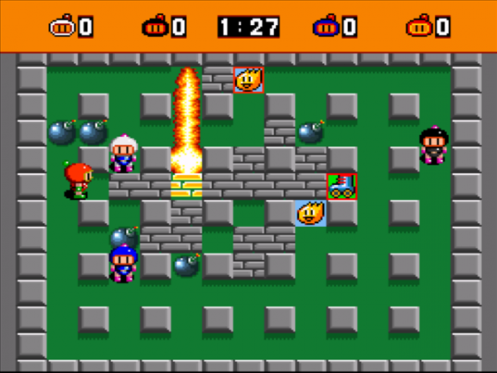
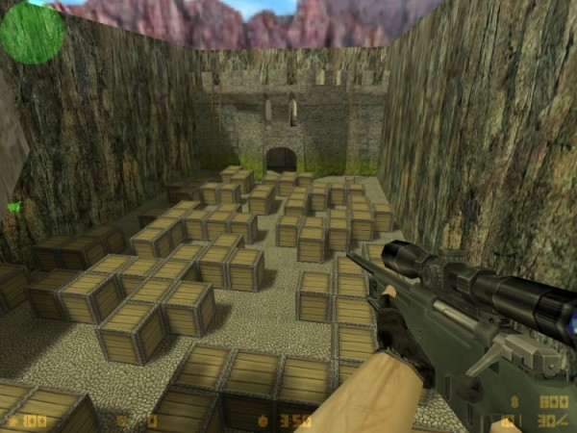
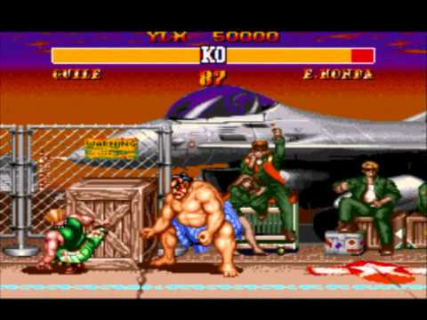
www.jamaatwomen.org

Slide 28
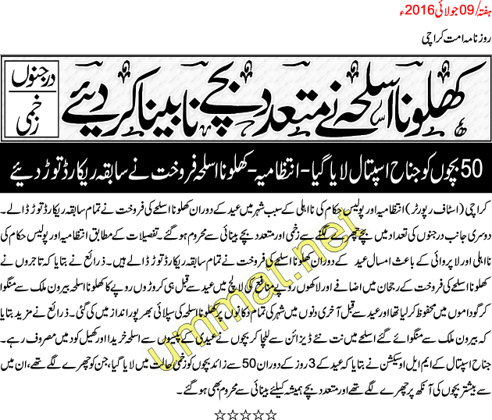
www.jamaatwomen.org

Slide 29
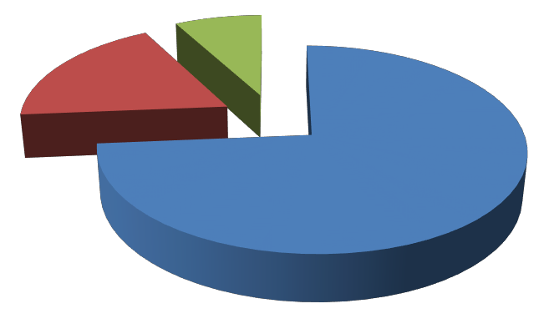
CHILDREN PREFER TO WATCH AND PLAY
Emotion based
Violence Oriented
informational
www.jamaatwomen.org

Slide 30
www.jamaatwomen.org

Slide 31
www.jamaatwomen.org

Slide 32
www.jamaatwomen.org

Slide 33
www.jamaatwomen.org

Slide 34
www.jamaatwomen.org

Slide 35
www.jamaatwomen.org

Slide 36
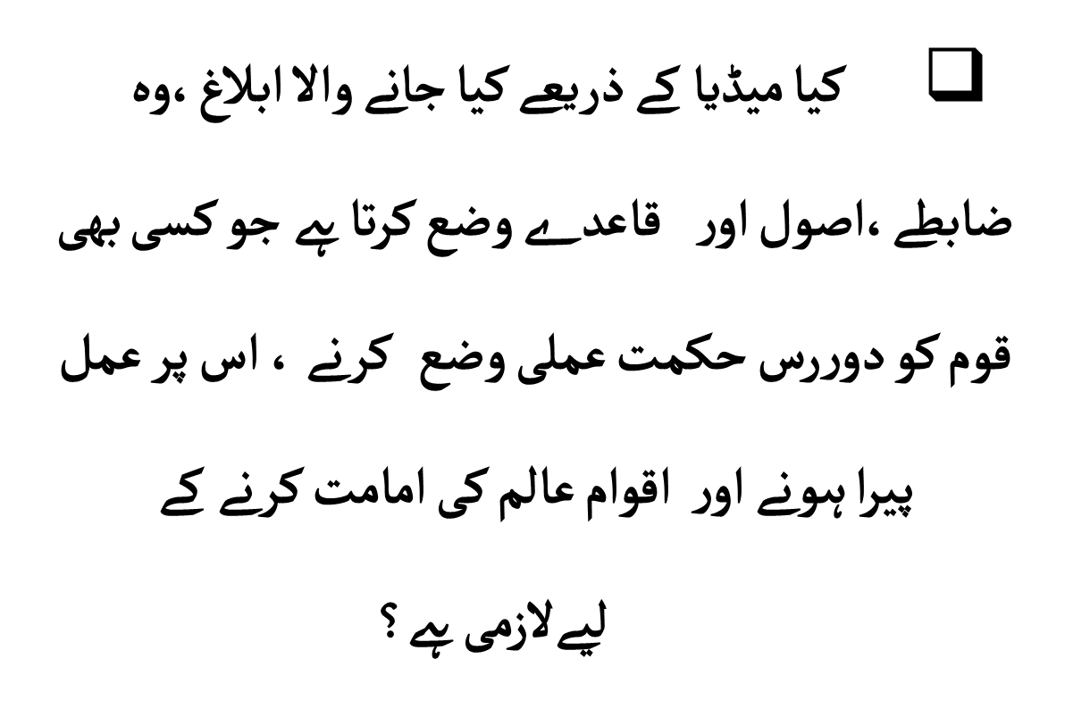
www.jamaatwomen.org

Slide 37
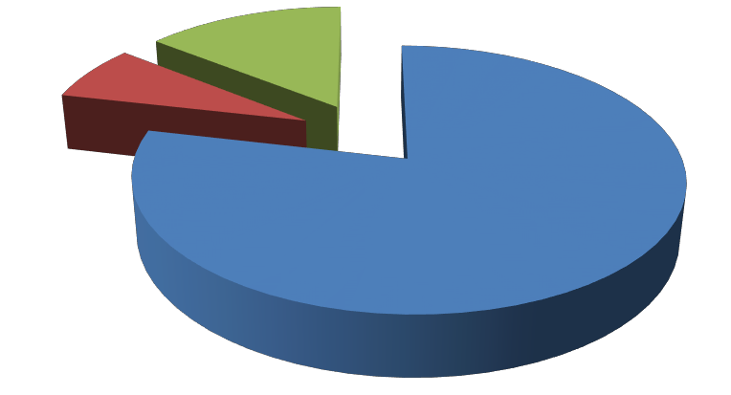
Yes
No
Sometimes
www.jamaatwomen.org

Slide 38
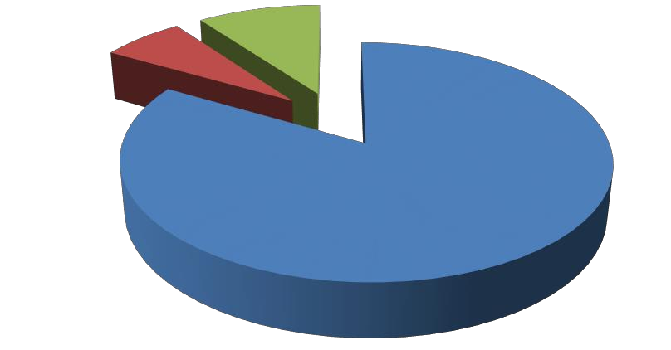
CHANGE IN MORAL VALUES
Yes
No
Sometimes
www.jamaatwomen.org

Slide 39
www.jamaatwomen.org

Slide 40
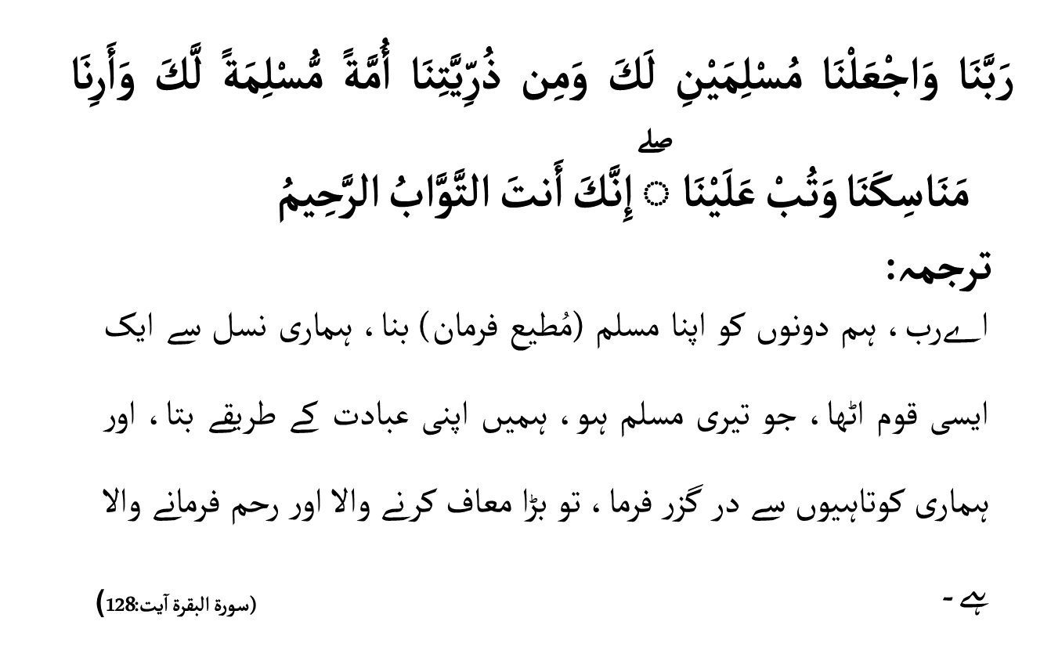
www.jamaatwomen.org

Slide 41
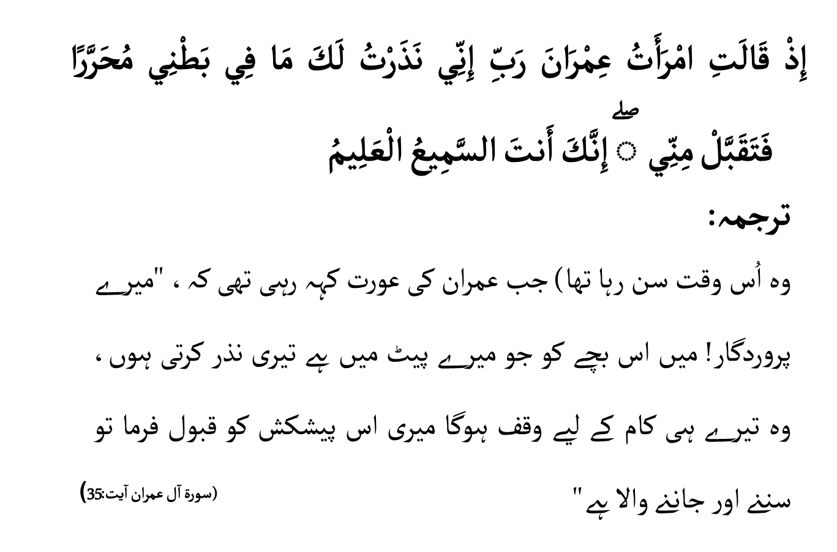
www.jamaatwomen.org

Slide 42
www.jamaatwomen.org

Slide 43
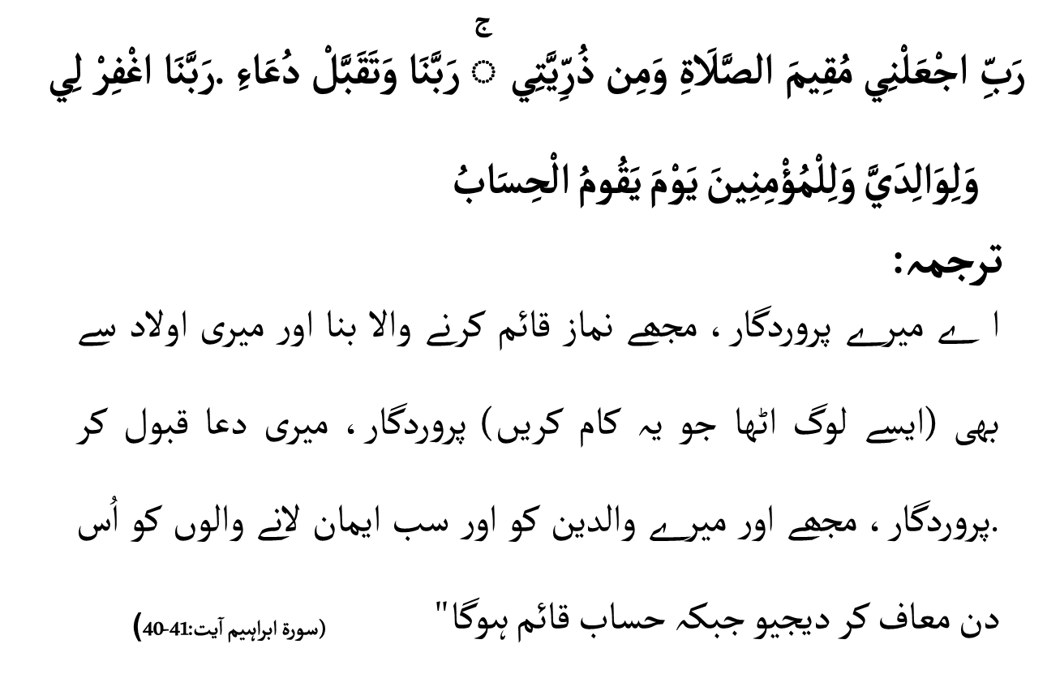
www.jamaatwomen.org

Slide 44
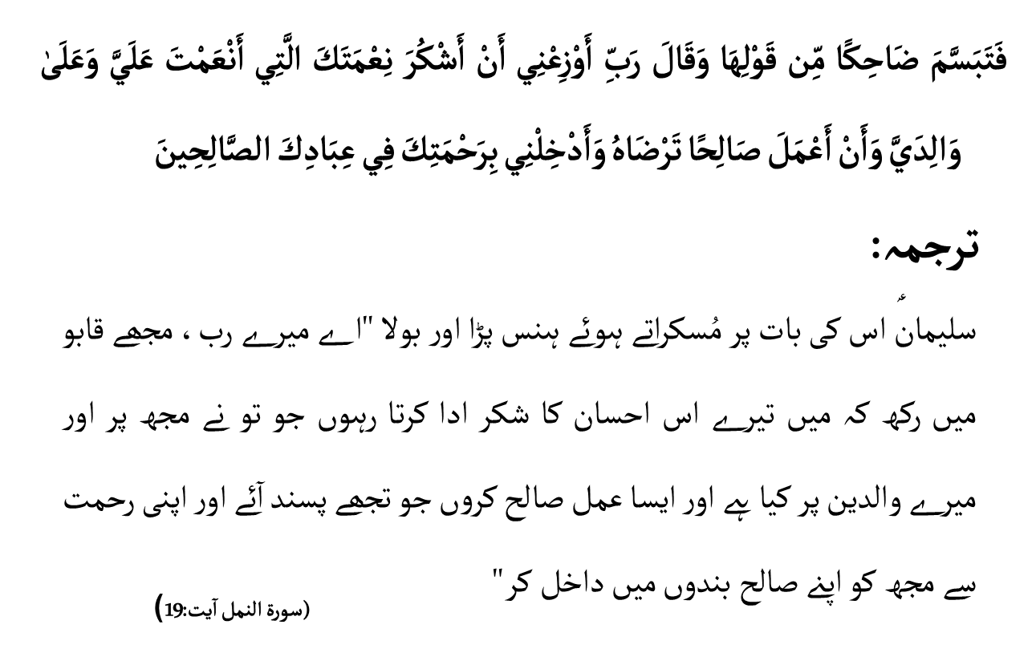
www.jamaatwomen.org

Slide 45
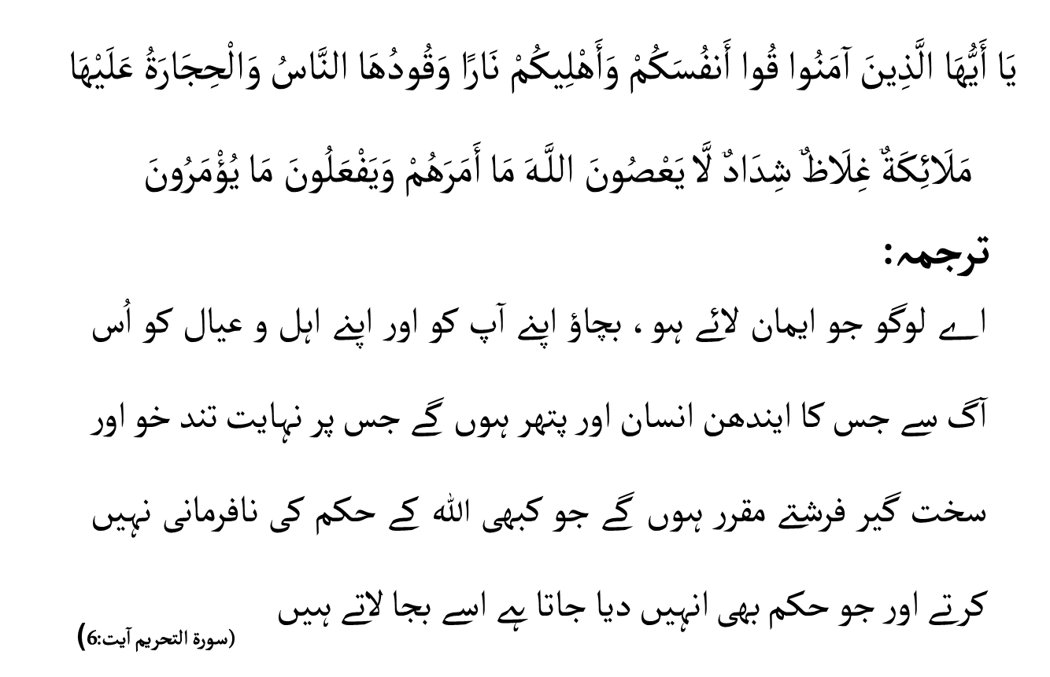
www.jamaatwomen.org

Slide 46
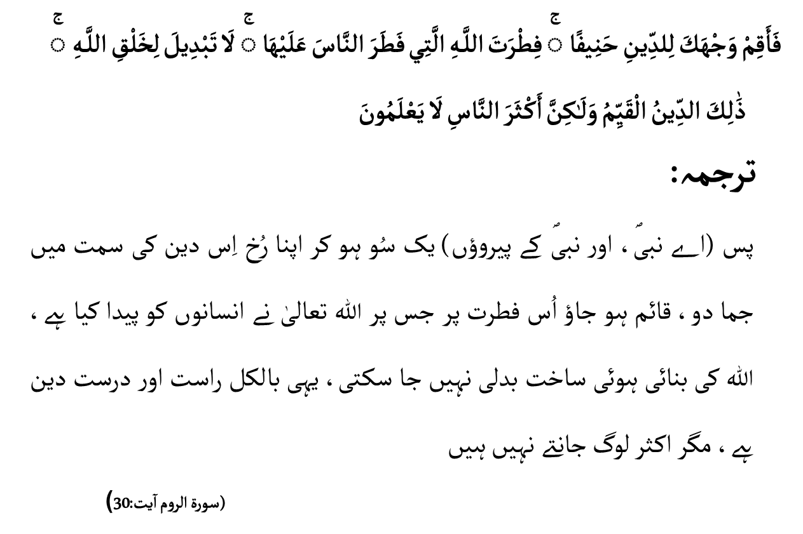
www.jamaatwomen.org

Slide 47
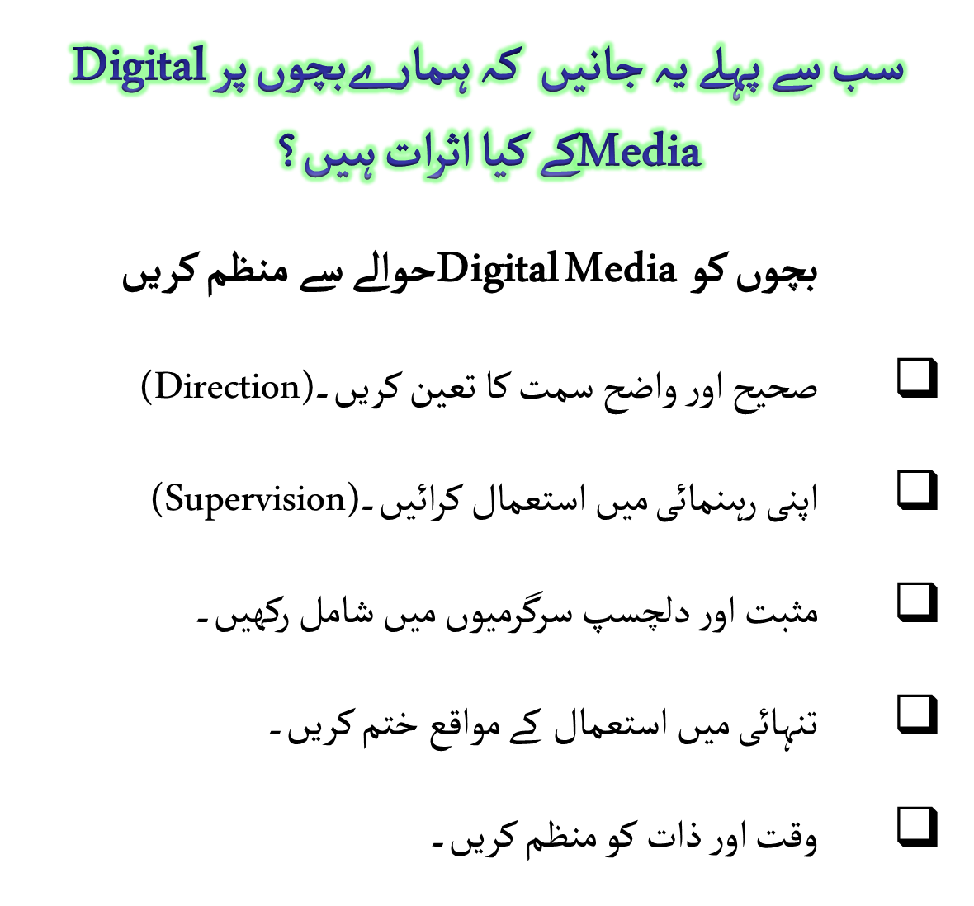
www.jamaatwomen.org

Slide 48
www.jamaatwomen.org

Slide 49
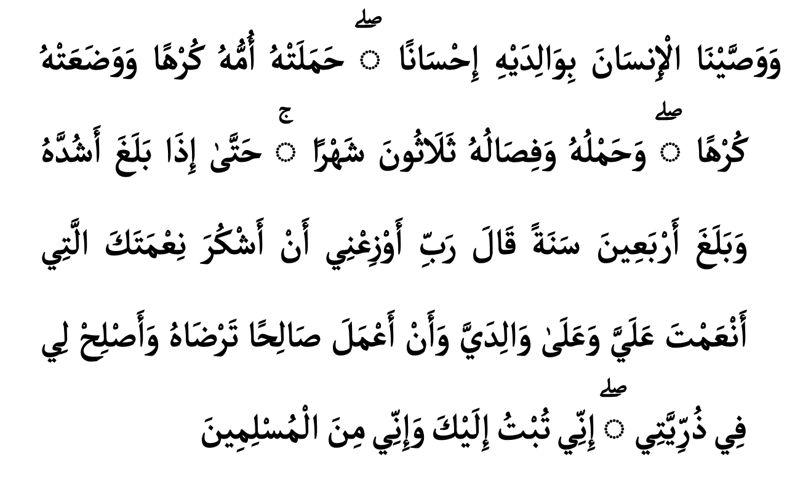
www.jamaatwomen.org

Slide 50
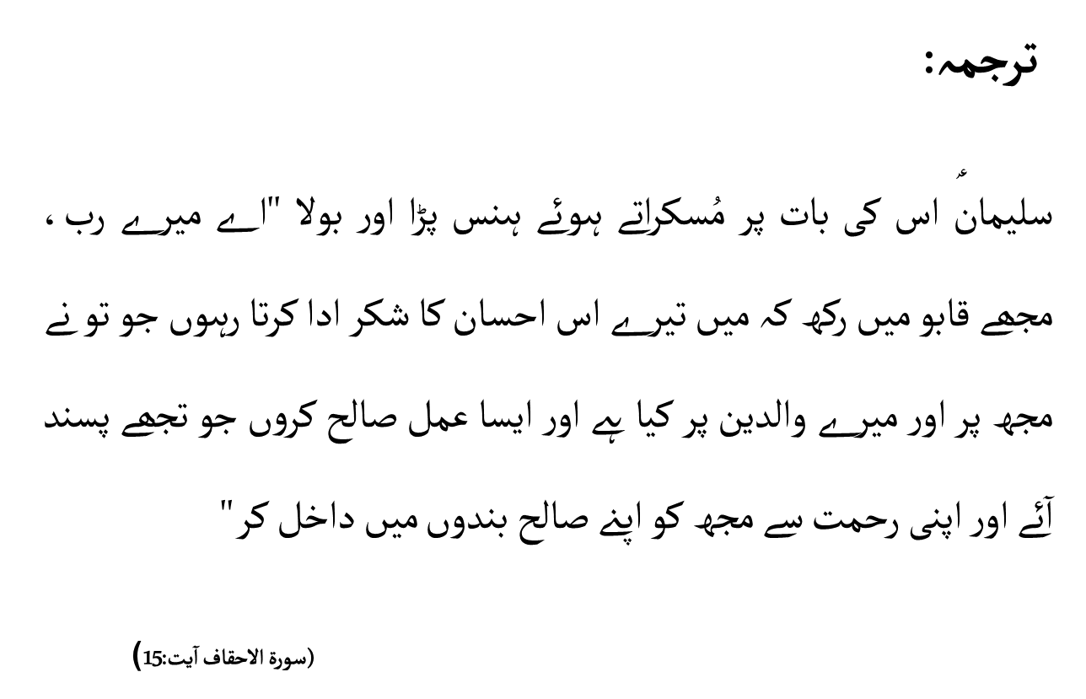
www.jamaatwomen.org

Slide 51
www.jamaatwomen.org

